Slide 1
Perspectives on Culture- Capturing National Culture through Graphic Novels
Somanand Saraswati
Doctoral Candidate
Pandit Deendayal Petroleum University, Gandhinagar, Gujarat India
Notes:
This template can be used as a starter file for a photo album.

Slide 2
“libraries……….has yet to discover graphic novels..” DeCandido, “Picture This: Graphic Novels in Libraries,” .

Slide 3
World of Graphics

Slide 4
India
Comics
Amar Chitra katha
Diamond Comics
Chacha Chaudhary
Tinkle

Slide 5
“by focusing on the microcosm, that is, individual suffering, the graphic narrative flows up into the crisis in the macrocosm, that is, the national, social crisis.”
(Basu 2017)

Slide 6
“Graphic novel is “a self-contained story that uses a combination of text and art to articulate the plot.” DeCandido, “Picture This: Graphic Novels in Libraries,” .

Slide 7
“The creators of graphic novel produce narrative and emotional impact by combining visual and textual elements towards understanding of histories and truths (political and social) about India.” (Agrawal 2016)

Slide 8
Caricatures are a powerful tool that allows to develop satire around the event.
Historical, political or social caricatures
are offering an insight into
our political realities,
social-economic conditions
Historical hypocrisies and dual standards.

Slide 9
“caricatures are the distorted representation of any individual with a fair amount of exaggerated physiognomies to reflect the inner nature of the individual” (Promod K. Nayar 2016)

Slide 10
How visuality have been used to represent society?

Slide 11
It not only communicates with its readers, but directly involves them and makes them the key players in the production of meaning.
Its ‘seeable’ and ‘sayable’ mode allows the reader to inhabit the virtual space

Slide 12
It is a major shift in Indian writing in English,
it became a social commentary and cultural critique of the nation’s flaws,
Accessing history through history verbal and the visual layers

Slide 13
Once freedom attained from the tight grips of colonialism, India felt the desperate need to re build the nation and its society and polity. This process of reconstruction has introduced massive changes in national consciousness. From colonialism to transitioning into constructing a new idea of nation; India has been in the midst of massive changes in national consciousness. Fanon has extensively explored how a national culture is constructed after colonialism. Interestingly, literature has always played an important role in reflecting the national consciousness. Graphic Novels in India is one such genre, which has been able to reflect how a nation is being perceived or imagined.

Slide 14
India has witnessed a huge emergence of Graphic Novels with the voices of the unheard, representing the fragmented identities. These entitlings make conscious effort to assert an identity different from the Eurocentric paradigms of nationalism. The authors counters the prevailing idea of nation and constructs her own 'idea of nation'. Furthermore, the words and graphics complement each other so dexteriously that the depiction of Indian society gets the visual impression alongwith the verbal portrayal that provides the reader with the distinct understanding.

Slide 15
Graphic novels of India

Slide 16
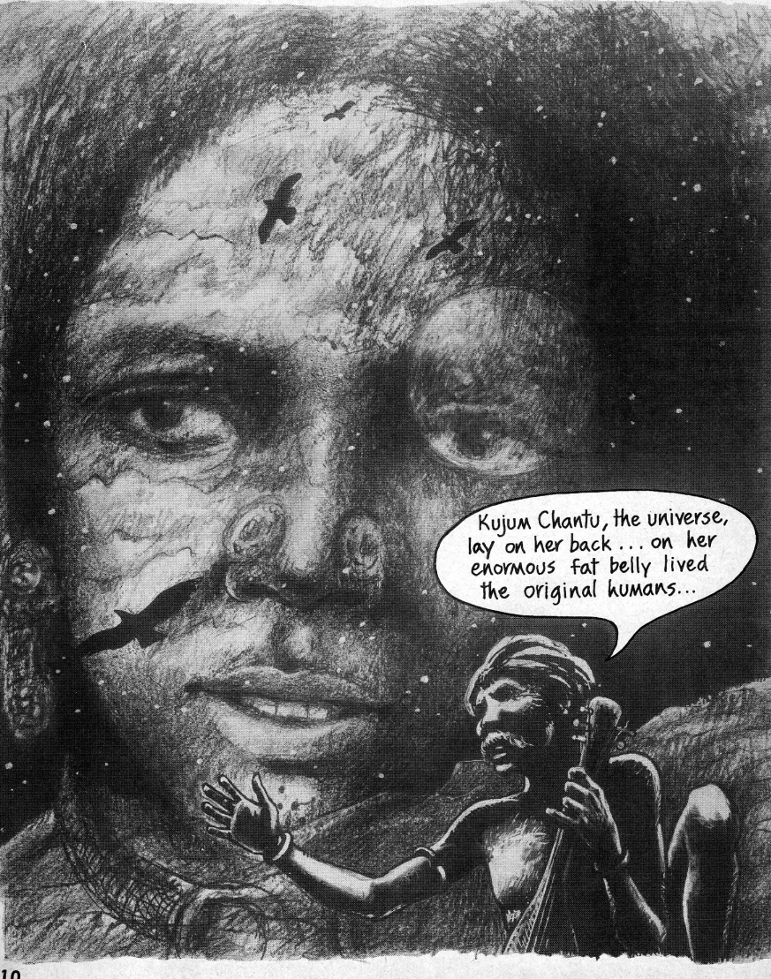
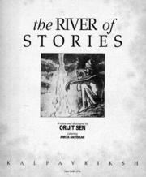
River of stories

Slide 17
Few examples how the novel questions the nation

Slide 18
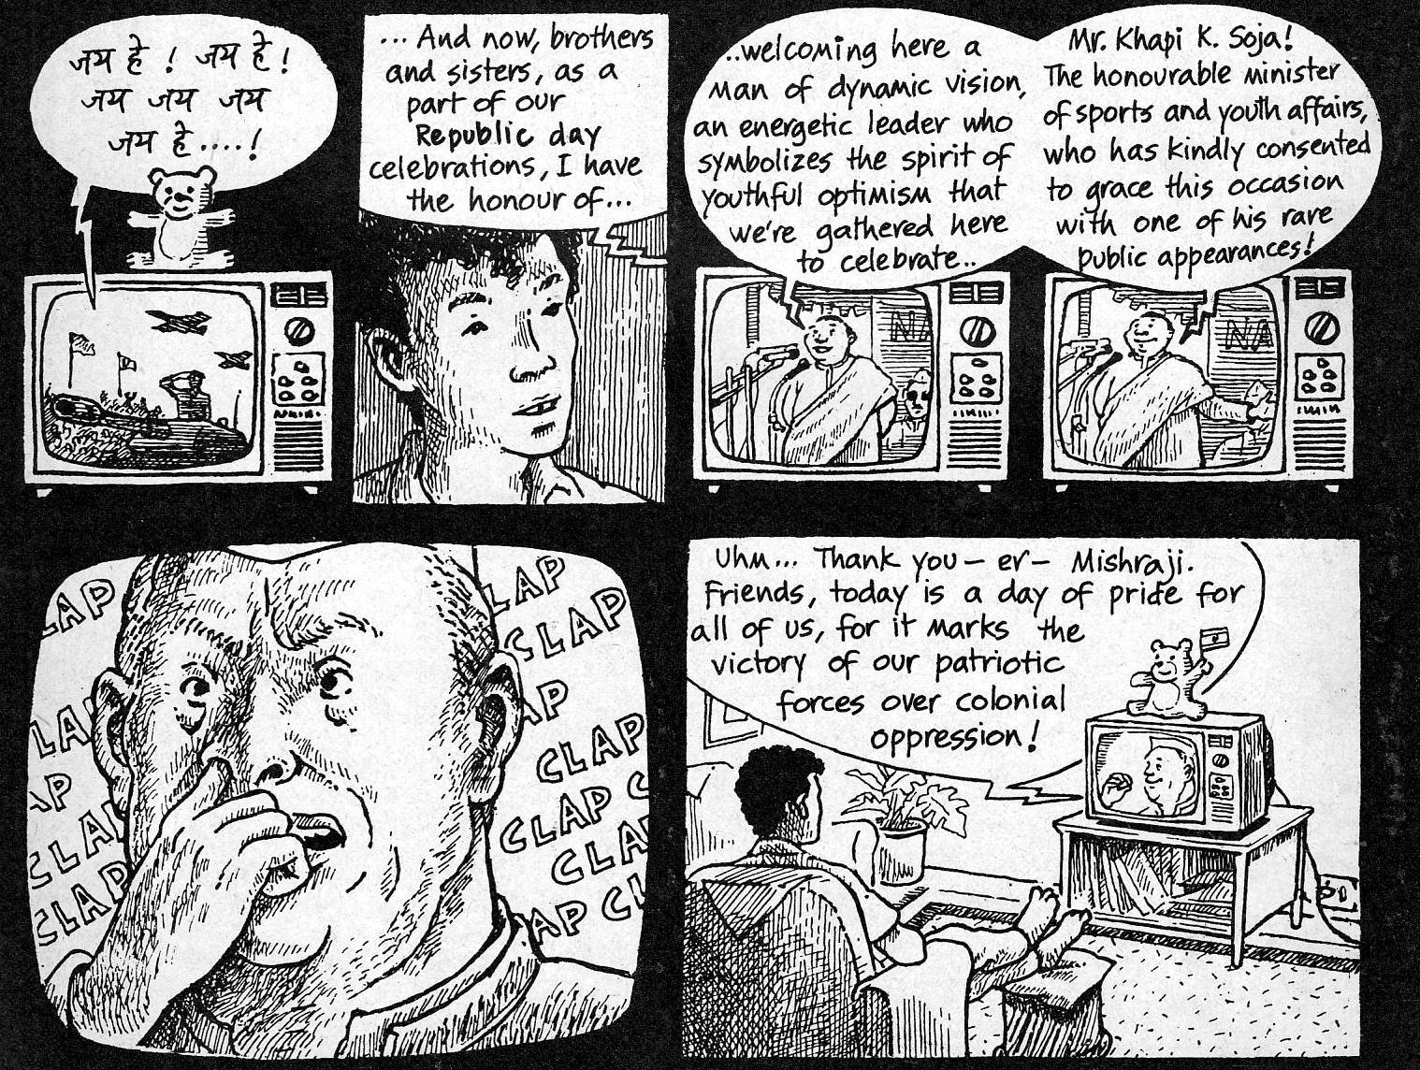
Grapic narritive

Slide 19
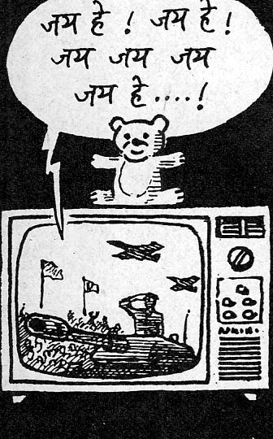
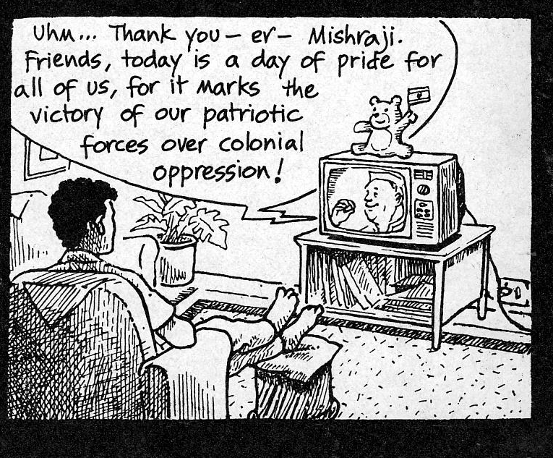

Slide 20
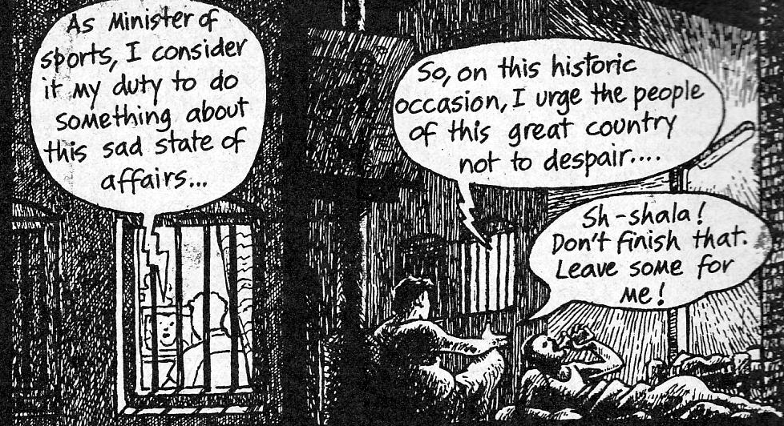
River of stories

Slide 21
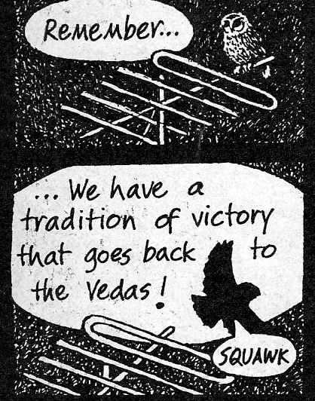
River of stories

Slide 22
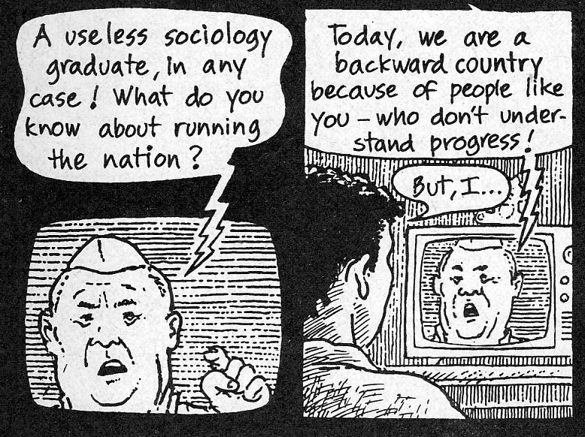
River of stories

Slide 23
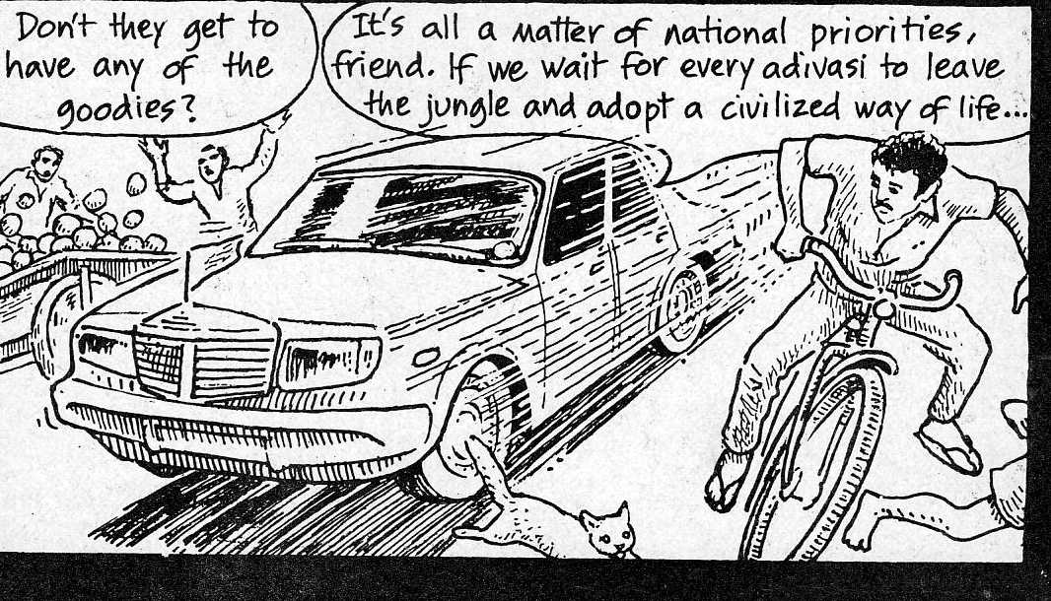
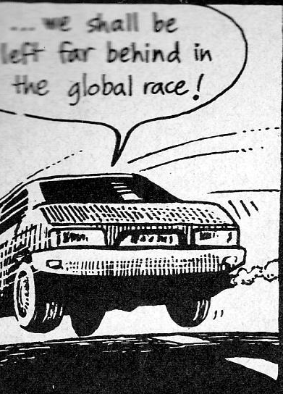
River of stories
Dream sequence gets over

Slide 24
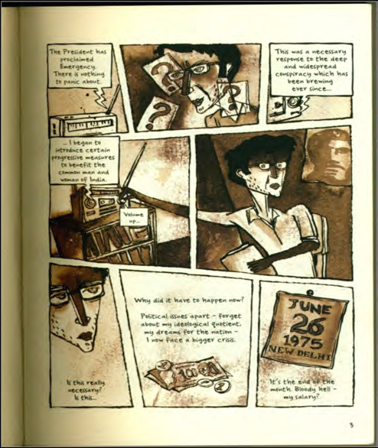
Delhi Calm
Emergency of 1975-1977

Slide 25
This Side That Side

Slide 26
Urban Graphics----Contemporary City’s Fragmented Realities through Graphic Novels

Slide 27
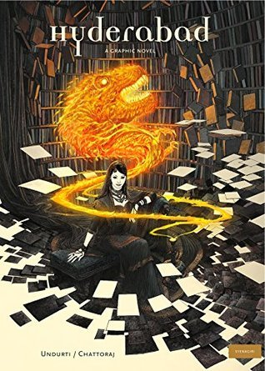
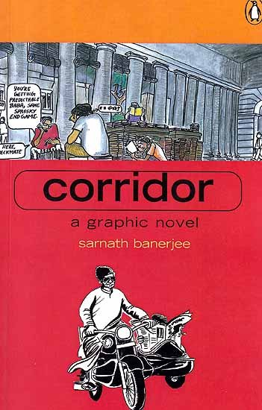
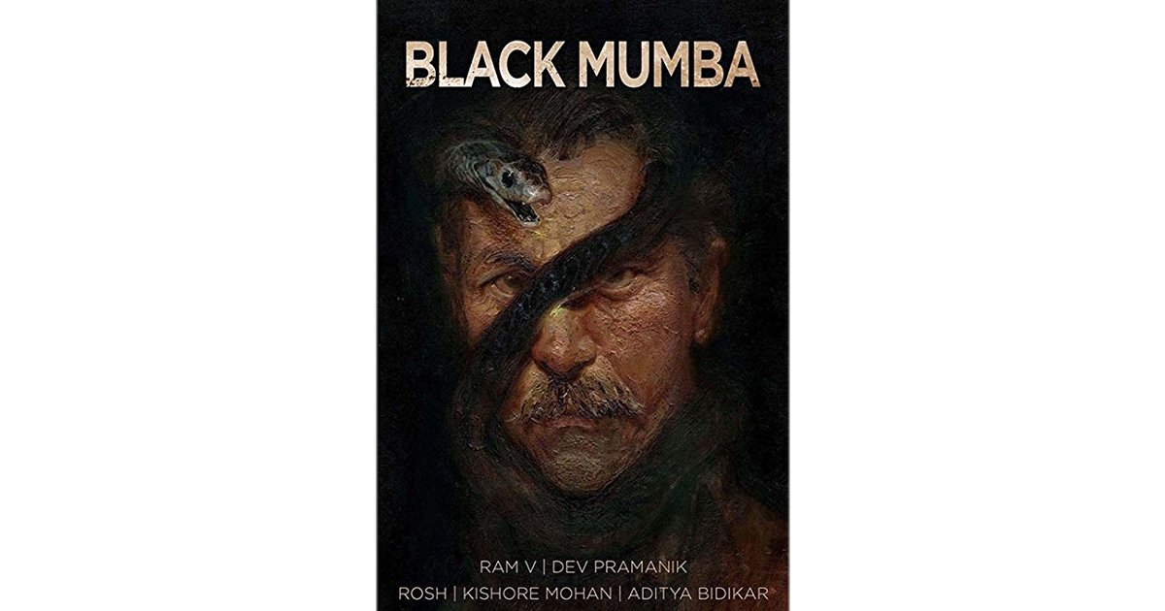
Urban Graphics----Contemporary City’s Fragmented Realities

Slide 28
Women and Culture

Slide 29
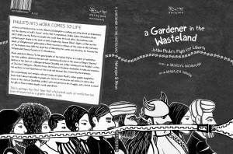
A Gardener in the Wasteland is an account of Jyotiba Phule’s struggle for liberty

Slide 30
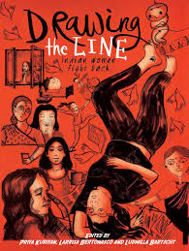
Drawing the Lines
14 accounts turned into chapters of lived experiences by women in India
Nirbhaya (a young girl who was brutally raped on 16 December 2012 in Delh)

Slide 31
Bhimayana: The Experience of Untouchability
his encounter with untouchability and
his fight against this inhuman practise

Slide 32
Kari

Slide 33
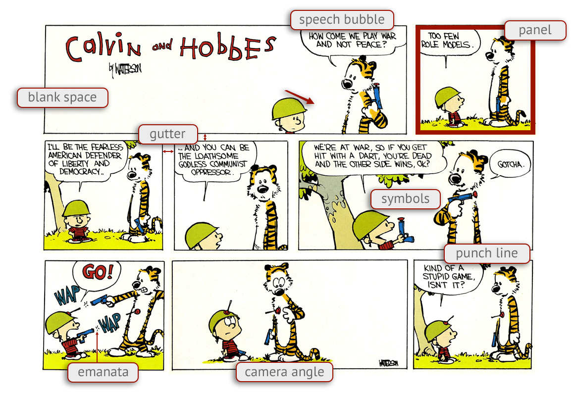
Decoding comics

Slide 35
Main Argument
Study of these novels shows that idea of nation is being constructed, questioned or reconstructed within the narratives of Graphic Novels in India. The paper tries to locate Graphic Novels in socio-cultural context of India. By examining select examples from a cluster of contemporary Graphic Novels, this paper explores the reoccurring themes and the way of visual storytelling. This paper attempts to examine how, alienation and fragmented identities of urban life is being represented through an imaginative alchemy of text and graphics.

Slide 36
thanks

Slide 37
Bibliography
Anderson, Benedict. Imagined Communities. London, 1982.
Basu, Antarleena. “Representation of History in the Indian Graphic Novel: An Analytical Study of History through the Frame of Graphic Narratives.” The International Academic Forum, December 8, 2017. https://doi.org/10.22492/ijah.4.2.03.
Bhabha, Homi. Nation and Narration. London: Routledge, 1991.
Chipkin, Ivor. "The Nature of African Nationalism." In Do South Africans Exist?: Nationalism, Democracy and the Identity of ‘the People’, 17-40. Johannesburg, South Africa: Wits University Press, 2007. www.jstor.org/stable/10.18772/12007044457.6
Fanon, Frantz. ON NATIONAL CULTURE, 1998.
Kennedy, Valerie, and Edward W. Said. Edward Said: a Critical Introduction. Cambridge: Polity, 2001.
Keller, Edmond J. "Identity, Citizenship, and Nation Building in Africa." In Identity, Citizenship, and Political Conflict in Africa, 3-17. Indiana University Press, 2014. www.jstor.org/stable/j.ctt16gzg15.4.

Slide 38
Nayar, Pramod K. “Indian Graphic Novel: Nation, History and Critique”. Routledge India, 2016. p. 8 Print.
Basu, A. “Representation of History in the Indian Graphic Novel: An Analytical Study of History through the Frame of Graphic Narratives.” IAFOR Journal of Arts & Humanities, 2017. https://doi.org/10.22492/ijah.4.2.03
Agrawal, Prachi. “Indian Graphic Novels Towards Decoding India”, Tolomeo Journal, 2016
Nayar, Pramod K. “Indian Graphic Novel: Nation, History and Critique”. Routledge India, 2016. p. 8 Print.
Mukherjee, Pia. “Graphic Ecriture: Gender and Magic Iconography in Kari.” Postcolonial Comics: Texts, Events, Identities. Eds. Binita Mehta and Pia Mukherji. New York & Oxon: Routledge, 2015. 157-169. Print.
Dogra, Sakshi. “Sex(uality) and The City: Queering Amrita Patil’s Kari”. The Apollonian. 2015
McCloud, S. Understanding comics: [the invisible art]. New York: Harper Perennial, 1994, Print
Patil, Amruta. “Kari”. Delhi: Harper Collins. 2008. Print.
Kuriyan, Priya, Bertonasco, Larissa. Barischt, Ludmilla. “Drawing the Line: Indian Women Fight Back”, Zubaan Publication. 2015. Print.

Slide 39
Chute, Hillary. “Comics as Literature? Reading Graphic Narrative.” PMLA, vol. 123, no. 2, 2008, pp. 452–465. JSTOR, JSTOR, www.jstor.org/stable/25501865
Singh, Neha. “Portrayal Of Women In Indian Media”. Arts & Education International Research Journal : Volume 4 Issue 1 (2017) ISSN 2349-1353. Pg 20.
Aditya. Singh. Ashwandeep. “Women And Poverty”. Arts & Education International Research Journal : Volume 4 Issue 1 (2017) ISSN 2349-1353. Pg 27.
Singh, Aarti. “Women Throughout The Ages”. Arts & Education International Research Journal : Volume 4 Issue 1 (2017) ISSN 2349-1353. Pg 53.
Sharma, Roshni. “Mage Of Refugee Women In Post- Partition Literature”. Arts & Education International Research Journal : Volume 4 Issue 1 (2017) ISSN 2349-1353. Pg 109.
Kotekar, Vivek. “Social Change in Women”. Arts & Education International Research Journal : Volume 4 Issue 1 (2017) ISSN 2349-1353. Pg 61.
Pinney, Christopher. “Photos of the Gods: the Printed Image and Political Struggle in India”. Reaktion Books, 2009. Print.
Gebhardt, Nadja. The Elephant in the Room: Women Draw Their World. Zubaan, 2017. Print.
Garva, Radhaben. “Picture This! Painting The Women's Movement” Zubaan, 2013. Print.
Goldman, Dan. “Priya's Shakti” Rattapallax, 2014. Print.
Chanani, Nidhi. Pashmina. HarperCollins Childrens Books, an Imprint of HarperCollins Publishers, 2018. Print.

